Slide 1

Warranty Claims Analysis for Peterbilt Motor Company
A Data-Driven Approach to Optimize Warranty Costs and Improve Reliability
Manisha Dornala (08-11-2024)

Slide 2
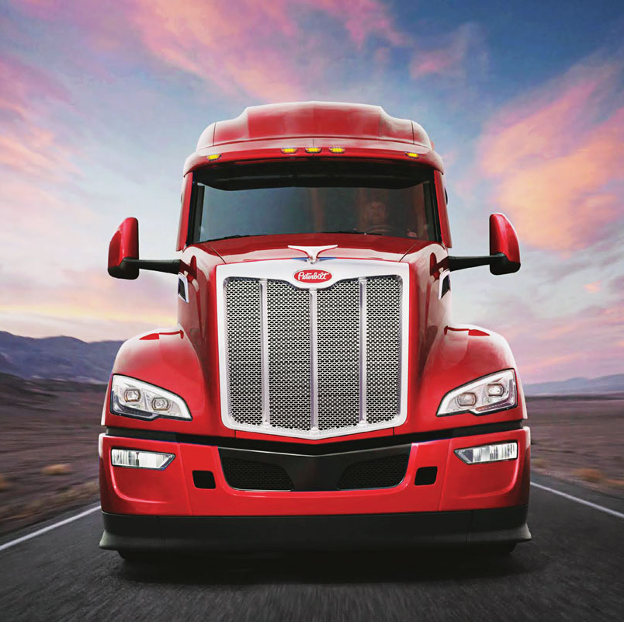
Project Overview
Introduction to Peterbilt Motor Company
Manufacturer of heavy-duty vehicles with customizable configurations.
Objective of the Project
Identify high-cost attributes and attribute pairings in warranty claims.
Develop a predictive model to guide future configurations and minimize warranty expenses.

Slide 3
Problem Statement
Challenges Addressed:
High warranty costs due to complex attribute interactions.
Need to predict configurations likely to incur higher warranty claims.
Key Questions:
Which attributes or combinations increase warranty costs?
What predictive modeling approaches can help quantify these relationships?

Slide 4
Data Overview
Datasets:
Attributes Data: List of eight attributes with option codes for various configurations.
Warranty Claims Data: Records tied to specific configurations, capturing warranty-related costs.
Data Goals:
Use data to analyze, identify, and model high-risk attribute combinations.

Slide 5
Proposed Solution
Strategic Recommendations:
Purposeful Innovation: Redesign high-risk components.
Individualized Solutions: Offer customer-specific, low-risk configurations.
Enduring Craftsmanship: Avoid high-risk attribute combinations.
Pride and Class: Emphasize low-risk configurations to boost brand reliability.
Cost Efficiency: Optimize inventory based on predicted reliability data.

Slide 6
Modeling Approach and Results
Approach Summary:
Data Preprocessing: Clean and structure data.
EDA and Feature Engineering: Identify patterns and create new features for attribute pairs.
Predictive Modeling: Tested models like logistic regression and random forests for best performance.
Model Interpretation: Used feature importance scores to identify high-risk configurations.
Results:
RMSE or similar metric from the predictive model.
Key attributes and attribute pairs associated with higher warranty costs.

Slide 7
Business Impact and Expected Outcomes
Benefits:
Reduced warranty costs through strategic redesign and preventive measures.
Enhanced customer satisfaction with reliable, customized configurations.
Improved resource management by aligning production with low-risk configurations.
Expected Outcomes:
Identification of high-cost attributes.
Predictive model for guiding future configurations.
Reinforcement of Peterbilt’s brand reputation as a reliable choice.

